Slide 1
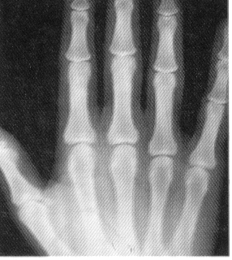
Waves in Action
OCR Module 7
W Richards
Worthing High School

Slide 2
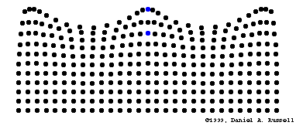

Slide 3
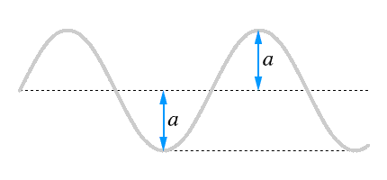
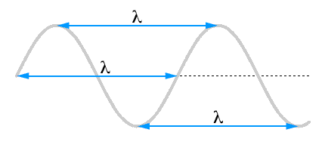
Some definitions…
Crest
1) Amplitude – this is “how high” the wave is:
Trough
2) Wavelength (λ) – this is the distance between two corresponding points on the wave and is measured in metres:
3) Frequency – this is how many waves pass by every second and is measured in Hertz (Hz)

Slide 4
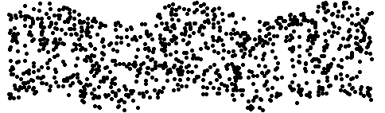

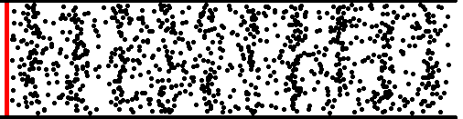

Some definitions…
Transverse waves are when the displacement is at right angles to the direction of the wave…
Longitudinal waves are when the displacement is parallel to the direction of the wave…

Slide 5
“Seeing” a wave
1) Quiet sound, low frequency (i.e. high wavelength):
2) Quiet sound, high frequency (i.e. low wavelength):
3) Loud sound, low frequency:
4) Loud sound, high frequency:

Slide 6
The Wave Equation
The wave equation relates the speed of the wave to its frequency and wavelength:
Wave speed (v) = frequency (f) x wavelength (λ)
in m/s in Hz in m
V
f
λ

Slide 7
Some example wave equation questions
A water wave has a frequency of 2Hz and a wavelength of 0.3m. How fast is it moving?
A water wave travels through a pond with a speed of 1m/s and a frequency of 5Hz. What is the wavelength of the waves?
The speed of sound is 330m/s (in air). When Dave hears this sound his ear vibrates 660 times a second. What was the wavelength of the sound?
Purple light has a wavelength of around 6x10⁻⁷m and a frequency of 5x10¹⁴Hz. What is the speed of purple light?
0.6m/s
0.2m
0.5m
3x10⁸m/s

Slide 8
Reflection
Angle of incidence = Angle of reflection
Normal
Incident ray
Reflected ray
Angle of incidence
Angle of reflection
Mirror

Slide 9
Refraction through a glass block:
Wave slows down and bends towards the normal due to entering a more dense medium
Wave slows down but is not bent, due to entering along the normal
Wave speeds up and bends away from the normal due to entering a less dense medium

Slide 10
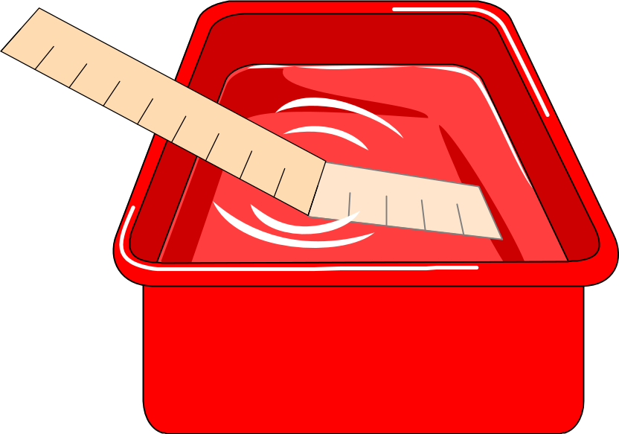
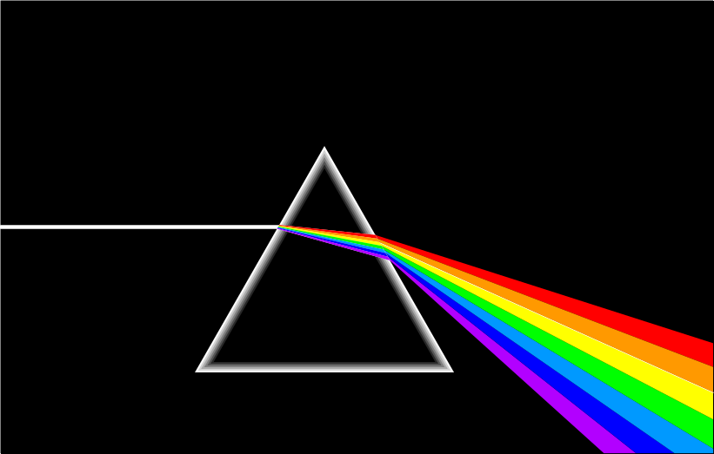

Slide 11
Refraction
Refraction is when waves ____ __ or slow down due to travelling in a different _________. A medium is something that waves will travel through. When a pen is placed in water it looks like this:
In this case the light rays are slowed down by the water and are _____, causing the pen to look odd. The two mediums in this example are ______ and _______.
Words – speed up, water, air, bent, medium

Slide 12
Wave diagrams
1) Reflection
2) Refraction
3) Refraction
4) Diffraction

Slide 13
Diffraction
Diffraction is when waves spread out from the edge of a gap.
More diffraction if the size of the gap is similar to the wavelength
More diffraction if wavelength is increased (or frequency decreased)

Slide 14
Finding the Critical Angle…
1) Ray gets refracted
2) Ray still gets refracted
4) Ray gets internally reflected
3) Ray still gets refracted (just!)
THE CRITICAL ANGLE

Slide 15
Uses of Total Internal Reflection
Optical fibres:
An optical fibre is a long, thin, _______ rod made of glass or plastic. Light is _______ reflected from one end to the other, making it possible to send ____ chunks of information
Optical fibres can be used for _________ by sending electrical signals through the cable. The main advantage of this is a reduced ______ loss.
Words – communications, internally, large, transparent, signal

Slide 16
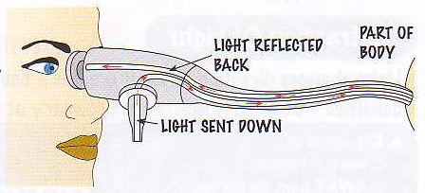
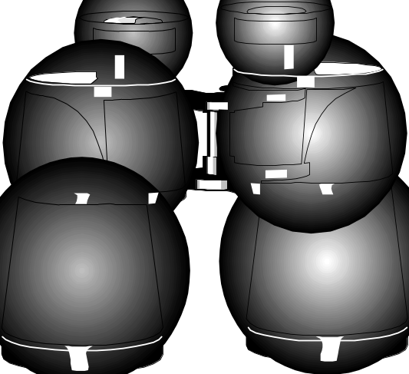
Other uses of total internal reflection
1) Endoscopes (a medical device used to see inside the body):
2) Binoculars and periscopes (using “reflecting prisms”)

Slide 17
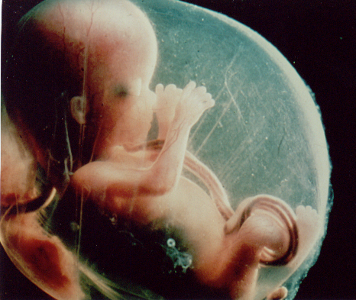



How does ultrasound work?
Ultrasound is the region of sound above 20,000Hz – it can’t be heard by humans. It can be used in pre-natal scanning:
How does it work?
Ultrasonic waves are partly _________ at the boundary as they pass from one _______ to another. The time taken for these reflections can be used to measure the _______ of the reflecting surface and this information is used to build up a __________ of the object.
Words – depth, reflected, picture, medium

Slide 18
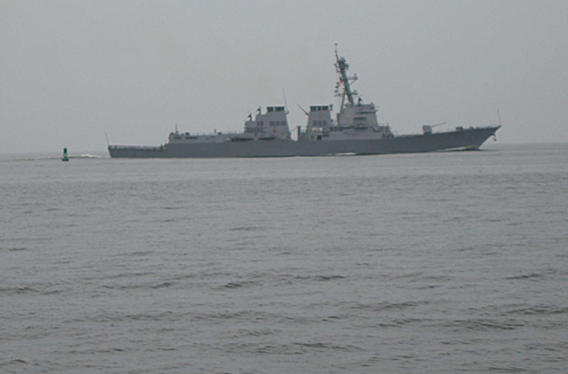

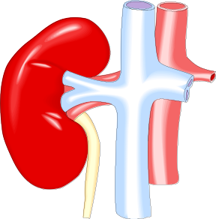

Other uses of ultrasound
1) Echo sounding
The ultrasound is reflected from the sea floor.
2) Breaking down kidney stones
Ultrasonic waves break kidney stones into much smaller pieces
3) Cleaning (including teeth)
Ultrasound causes dirt to vibrate dirt off without damaging the object

Slide 19
The Structure of the Earth
A thin crust - 10-100km thick
A mantle – has the properties of a solid but it can also flow
A core – made of molten nickel and iron. Outer part is liquid and inner part is solid
How do we know this? These facts have all been discovered by examining seismic waves (earthquakes)

Slide 20
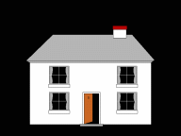
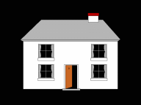
Seismic waves
Earthquakes travel as waves through the Earth – we call them SEISMIC WAVES. There are two types:
P waves:
They are longitudinal so they cause the ground to move up and down
They can pass through solids and liquids
They go faster through more dense material
S waves:
They are transverse so they cause the ground to move from right to left
They ONLY pass through solids
They are slower than P waves
They go faster through more dense material

Slide 21
Seismic waves
S waves will only travel through a solid
P waves travel through the Earth and are refracted when they pass through a medium
The paths of these waves are all curved because density is gradually changing
These observations tell us 3 things about the Earth: 1) It has a thin crust, 2) it has a semi-fluid mantle where density increases with depth, 3) a core with a liquid outer part and a solid inner part.

Slide 22



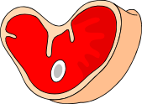
The electromagnetic spectrum
Each type of radiation shown in the electromagnetic spectrum has a different wavelength and a different frequency:
High frequency, _____ wavelength
Low frequency, _____ (high) wavelength
Gamma rays | X-rays | Ultra violet | Visible light | Infra red | Microwaves | Radio/TV
γ
Each of these types travels at the same speed through a _______ (300,000,000m/s), and different wavelengths are absorbed by different surfaces (e.g. infra red is absorbed very well by ___________ surfaces). This absorption may heat the material up (like infra red and _______) or cause an alternating current (like in a __ _______).
Words – black, microwaves, long, short, TV aerial, vacuum

Slide 23
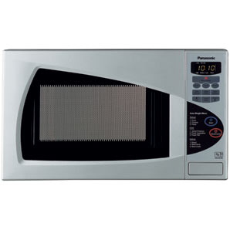
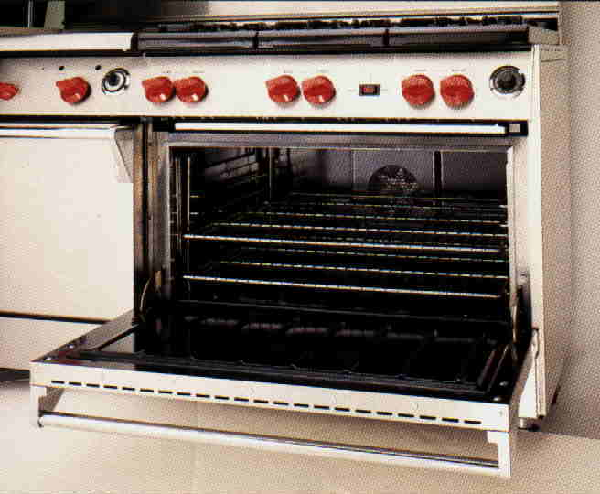
How Microwaves and Infra-red work
Microwaves are absorbed by water molecules up to a depth of a few centimetres. The heat then reaches the centre of the food by conduction.
Infra-red waves are absorbed by the surface of the material and the energy is then passed to the centre of the food by conduction.
The higher the frequency of the wave, the greater its energy

Slide 24
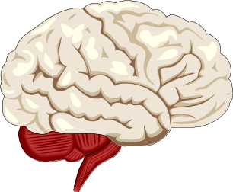
X-rays and gamma (γ) rays
X-rays are absorbed by ____ parts of the body, like ____. Unfortunately, over-exposure to x-rays will damage cells.
Gamma rays can be used to treat _______. A gamma ray source is placed outside the body and rotated around the outside of the tumour. Doing this can ___ the cancerous cells without the need for ______ but it may damage other cells and cause sickness.
Tracers can also be used – these are small amounts of ___________ material that can be put into a body to see how well an organ or ______ is working.
Words – radioactive, gland, cancer, hard, bones, kill, surgery

